Slide 1
CS217 - Object Oriented Programming
Notes:
CS217 - Object Oriented Programming

Slide 2
Prerequisite
Course:
CS217- Object Oriented Programming
Pre- Requisite
Programming Fundamentals

Slide 3
Evaluation Criteria
Assessment | Weightage
Sessional 1 | 15%
Sessional 2 | 15%
Quiz | 10%
Assignment | 10%
Project | 10%
Final Exam | 40%

Slide 4
Structures
A Structure is a collection of related data items, possibly of different types.
A structure type in C++ is called struct.
A struct is heterogeneous in that it can be composed of data of different types.
In contrast, array is homogeneous since it can contain only data of the same type.
Notes:
CS217 - Object Oriented Programming

Slide 5
Structures
Structures hold data that belong together.
Examples:
  Student record: student id, name, major, gender, start year, …
  Bank account: account number, name, currency, balance, …
  Address book: name, address, telephone number, …
In database applications, structures are called records.

Slide 6
Structures
Individual components of a struct type are called members (or fields).
Members can be of different types (simple, array or struct).
A struct is named as a whole while individual members are named using field identifiers.
Complex data structures can be formed by defining arrays of structs.

Slide 7
struct basics
Definition of a structure:
struct <struct-type>{
<type> <identifier_list>;
<type> <identifier_list>;
...
} ;
Example:
struct Date {
int day;
int month;
int year;
} ;
Each identifier
defines a member
of the structure.
The “Date” structure
has 3 members,
day, month & year.

Slide 8
struct examples
Example:
struct StudentInfo{
int Id;
int age;
char Gender;
double CGA;
};
Example:
struct StudentGrade{
char Name[15];
char Course[9];
int Lab[5];
int Homework[3];
int Exam[2];
};
The “StudentInfo”
structure has 4 members
of different types.
The “StudentGrade”
structure has 5
members of
different array types.

Slide 9
struct examples
Example:
struct BankAccount{
char Name[15];
int AcountNo[10];
double balance;
Date Birthday;
};
Example:
struct StudentRecord{
char Name[15];
int Id;
char Dept[5];
char Gender;
};
The “BankAcount”
structure has simple,
array and structure
types as members.
The “StudentRecord”
structure has 4
members.

Slide 10
struct basics
Declaration of a variable of struct type:
<struct-type> <identifier_list>;
Example:
StudentRecord Student1, Student2;
Student1 and Student2 are variables of StudentRecord type.
Name
Id Gender
Dept
Name
Id Gender
Dept
Student1
Student2

Slide 11
Ex. 1: struct basics
The members of a struct type variable are accessed with the dot (.) operator:
<struct-variable>.<member_name>;
Example:
strcpy(Student1.Name, "Chan Tai Man");
Student1.Id = 12345;
strcpy(Student1.Dept, "COMP");
Student1.gender = 'M';
cout << "The student is ";
switch (Student1.gender){
case 'F': cout << "Ms. "; break;
case 'M': cout << "Mr. "; break;
}
cout << Student1.Name << endl;
Student1
Name
Id Gender
Dept
Chan Tai Man
12345 M
COMP

Slide 12
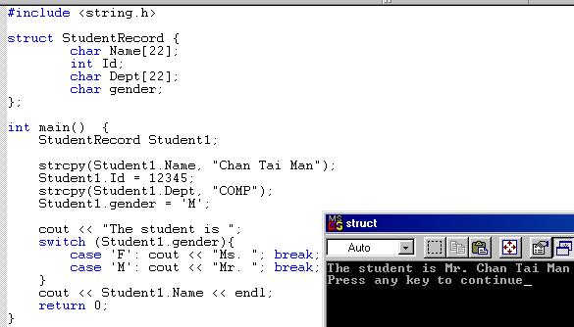

Slide 13
Ex. 2: struct-to-struct assignment
The values contained in one struct type variable can be assigned to another variable of the same struct type.
Example:
strcpy(Student1.Name,
"Chan Tai Man");
Student1.Id = 12345;
strcpy(Student1.Dept, "COMP");
Student1.gender = 'M';
Student2 = Student1;
Student1
Chan Tai Man
12345 M
COMP
Chan Tai Man
12345 M
COMP
Student2

Slide 14
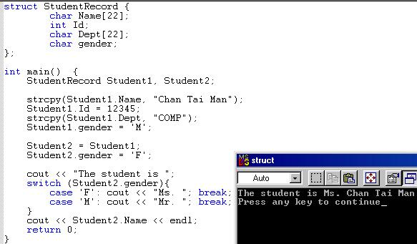

Slide 15
Ex. 3-5: Nested structures
We can nest structures inside structures.
Examples:
struct point{
double x, y;
};
point P;
struct line{
point p1, p2;
};
line L;
struct triangle{
point p1, p2, p3;
};
triangle T;
(P.x, P.y)
(L.p2.x, L.p2.y)
(L.p1.x, L.p1.y)
(T.p2.x, T.p2.y)
(T.p3.x, T.p3.y)
(T.p1.x, T.p1.y)

Slide 16
Ex. 3-5: Nested structures
We can nest structures inside structures.
struct line{
point p1, p2;
};
line L;
(L.p2.x, L.p2.y)
(L.p1.x, L.p1.y)
line
p1 p2
x y x y

Slide 17
Ex. 3-5: Nested structures
Assign values to the variables P, L, and T using the picture:
point P;
line L;
triangle T;
(4, 11)
(10, 9)
(2, 7)
(6, 5)
Ex. 3: Graph a point
Ex. 4: Graph a line
Ex. 5: Graph a triangle
(8, 3)
(2, 0)

Slide 18
Ex. 3-5: Nested structures
point P;
line L;
triangle T;
P.x = 4;
P.y = 11;
(4, 11)
(10, 9)
L.p1.x = 2;
L.p1.y = 7;
L.p2.x = 10;
L.p2.y = 9;
(2, 7)
(6, 5)
T.p1.x = 2;
T.p1.y = 0;
T.p2.x = 6;
T.p2.y = 5;
T.p3.x = 8;
T.p3.y = 3;
(8, 3)
(2, 0)

Slide 19
Ex. 3: Graphing a Point
x
0
1
2
3
4
5
6
7
8
0
10
11
12
13
14
15
1
2
(x₁, y₁)
*
y
3
4
5

Slide 20
struct point {int x, y;};
void user_input(point&);
void graph_point(char grid[NUMBER_ROWS][NUMBER_COLS], point);
void print_grid(char grid[NUMBER_ROWS][NUMBER_COLS]);
void set_background(char grid[][NUMBER_COLS]);
void user_input(point& P){ // pass by reference
// get user input and check that it is on the grid
do{
cout << "Enter column (x<" << NUMBER_COLS << ") & row (y<"
<< NUMBER_ROWS <<") of the 1st point: ";
cin >> P.x >> P.y;
} while ((P.y<0) || (P.y >= NUMBER_ROWS) ||
(P.x<0) || (P.x >= NUMBER_COLS));
}
// Put a point on the grid
void graph_point(char grid[][NUMBER_COLS], point P){
grid[P.y][P.x] = '*';
}

Slide 21
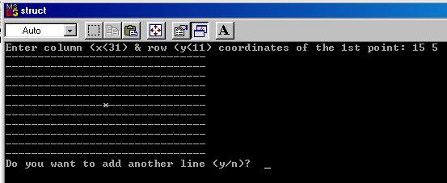
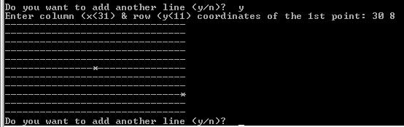

Slide 22
Ex. 4: Trajectory Between 2 Points
x
0
1
2
3
4
5
6
7
8
0
10
11
12
13
14
15
1
(x₁, y₁)
*
2
*
y
3
*
4
*
5
(x₂, y₂)
*
The equation of a line going through two points (x₁, y₁) & (x₂, y₂) can be represented by:
  (y-y₁)/ (x-x₁) = (y₂-y₁)/(x₂-x₁)
  or y = ((y₂-y1)/(x₂-x₁)) (x-x₁) + y₁
where (y₂-y₁)/(x₂-x₁) is called the slope.

Slide 23
// use struct to graph line between two points
#include <ctype> // for tolower
#include <iostream>
using namespace std;
int const NUMBER_ROWS = 11;
int const NUMBER_COLS = 31;
struct point {int x, y;};
struct line {point p1, p2;};
void user_input (line&);
void graph_line (char grid[NUMBER_ROWS][NUMBER_COLS], line);
void print_grid(char grid[NUMBER_ROWS][NUMBER_COLS]);
void set_background (char grid[][NUMBER_COLS]);

Slide 24
// Graph line between two points
int main(){
// set an array for the grid
char grid[NUMBER_ROWS][NUMBER_COLS];
line line1;
int row1=0, col1=0, row2=0, col2=0;
char do_another;
// function call to fill background of grid with ‘-’
set_background(grid);
do{ // do-while loop allows multiple lines
// get user input
user_input(line1);
// put ‘*’ into array to graph the line(s) on the grid
graph_line(grid, line1);
// print the grid from the array to the screen
print_grid(grid);
cout << "Do you want to add another line (y/n)? ";
cin >> do_another;
do_another = tolower(do_another);
} while (do_another == 'y');
return 0;
}

Slide 25
Ex. 4: More on Graphing Line
//A function to get user input and check that it is on the grid.
void user_input(line& line1){
do{
cout << "Enter column (x<" << NUMBER_COLS
<< ") & row (y<" << NUMBER_ROWS
<< ") coordinates of the 1st point: ";
cin >> line1.p1.x >> line1.p1.y;
} while ((line1.p1.y<0) ||
(line1.p1.y>=NUMBER_ROWS) ||
(line1.p1.x<0) ||
(line1.p1.x >= NUMBER_COLS));
// use another do-while loop for the 2nd point, col2 and row2
}

Slide 26
Ex. 4: More on Graphing Line
void graph_line(char grid[][NUMBER_COLS], line line1){
int row, col;
double rise, run, slope;
// one point
if((line1.p1.y==line1.p2.y)&&(line1.p1.x==line2.p2.x))
grid[line1.p1.y][line1.p1.x] = '*';
else if(line1.p2.x==line1.p1.x){ // infinite slope
if (line1.p1.y < line1.p2.y){
for(row=line1.p1.y; row <= line1.p2.y; row++)
grid[row][line1.p1.x] = '*';
}
else{
for(row=line1.p1.y; row >= line1.p2.y; row--)
grid[row][line1.p1.x] = '*';
}
}

Slide 27
Ex. 4: More on Graphing Line
else{
rise=line1.p2.y-line1.p1.y; run=line1.p2.x-line1.p1.x;
slope = (double)rise / run; // run cannot = 0
if (run >0){
for(col = line1.p1.x; col <= line1.p2.x; col++){
// line1.p1.y is offset for starting point
row=(int)(slope*(col–line1.p1.x)+line1.p1.y);
grid[row][col] = '*';
}
}
else{
for(col=line1.p1.x; col >= line1.p2.x; col--){
row=(int)(slope*(col–line1.p1.x)+line1.p1.y);
grid[row][col] = '*';
}
}
}
}

Slide 28
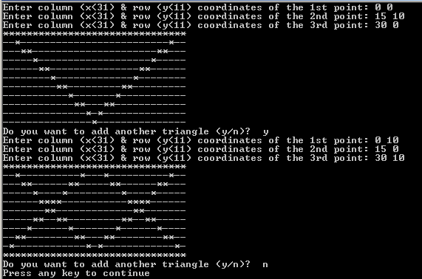

Slide 29
Arrays of structures
An ordinary array: One type of data
An array of structs: Multiple types of data in each array element.
0 1 2 … 98 99
0 1 2 … 98 99

Slide 30
Arrays of structures
We often use arrays of structures.
Example:
StudentRecord Class[100];
strcpy(Class[98].Name, "Chan Tai Man");
Class[98].Id = 12345;
strcpy(Class[98].Dept, "COMP");
Class[98].gender = 'M';
Class[0] = Class[98];
Chan Tai Man
12345 M
COMP
. . .
0 1 2 … 98 99

Slide 31
Arrays inside structures
We can use arrays inside structures.
Example:
struct square{
point vertex[4];
};
square Sq;
Assign values to Sq using the given square
(4, 3)
(10, 3)
(4, 1)
(10, 1)
x y
x y
x y
x y

